Slide 1
Welcome
Aviation Advisory Board
April 19, 2013

Slide 2
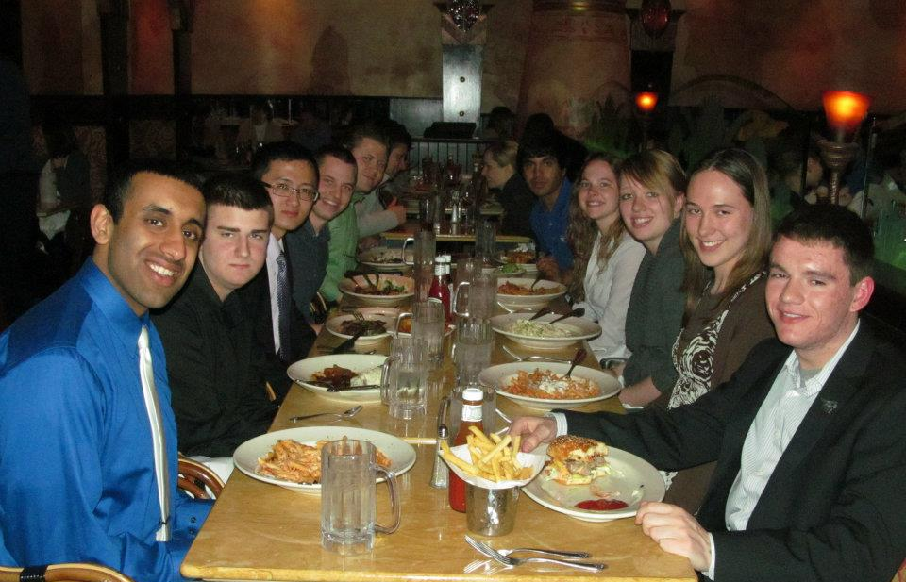
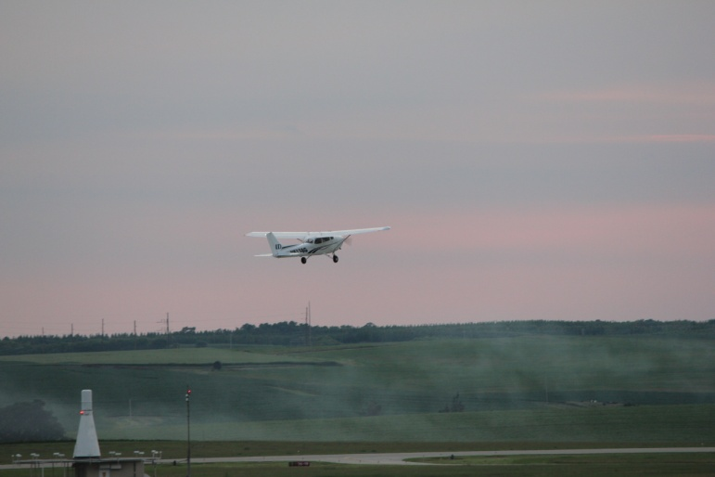
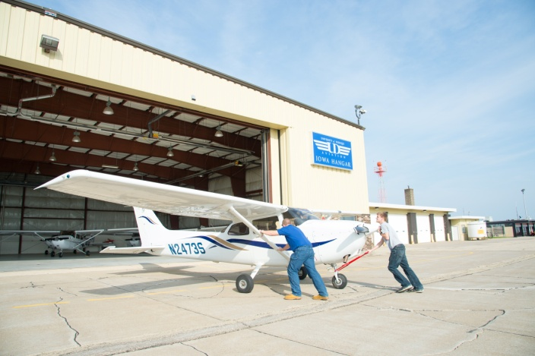
Program Highlights
Enrollment overview
Department graduates & hiring
Inbound class & co-horts
Flight equipment
Scholarships (Honors Convocation)
Non-towered airfield operations
Checklist discipline & the role of the CFI
Flight Team to Nationals
New management program w/ concentrations
New Life Flight certificate program
Breakout sessions
  FO Qualifications
  UAS Program
  MS Aviation

Slide 3
Enrollment By Major

Slide 4
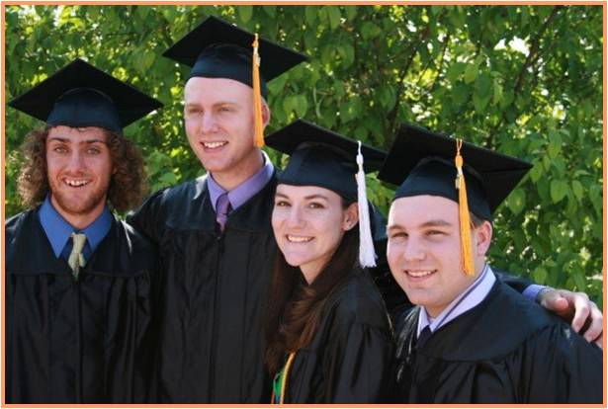
Department Graduates
2011/2012 Academic Year
43 Graduates by program
21 Management
22 Flight
8 Double majors (AVI, FLI, BAC)

Slide 5
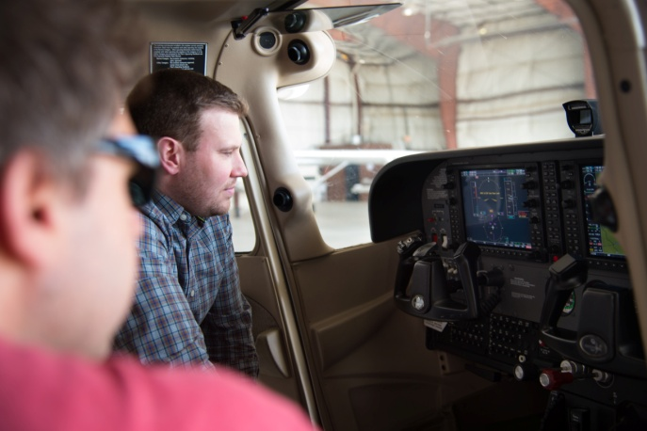
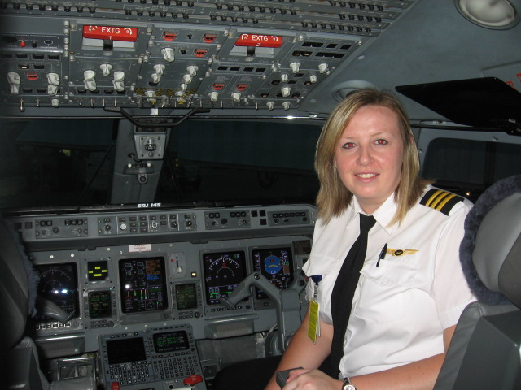
Department Graduates
2011 Data
100% of Management grads employed
88% of Flight grads employed
National average for college grads – 56.3% unemployed or underemployed
National average salary $27,000
UD grad avg salary $24,800 Management
UD grad avg salary $27,800 Flight

Slide 6





Hiring
Outlook
Positioning

Slide 7
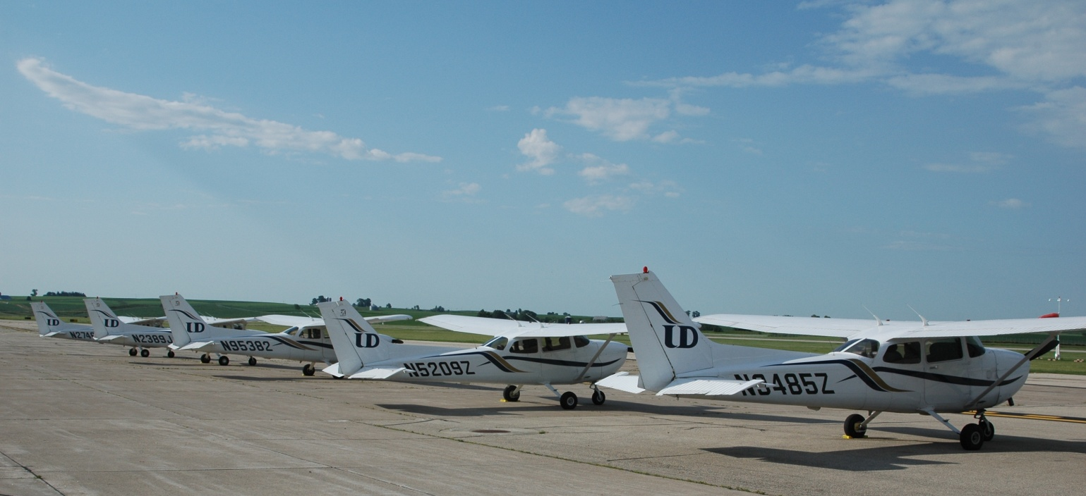
Training Fleet
AY 2012/13
Aircraft | Average Age | Average Total Time
11 C172 SP (G-1000) | 4.5 | 1745
4 C172R | 10.8 | 4094
3 TB20 (Trinidad) | 14.3 | 3875
2 PA44 (Seminole) | 9 | 3025

Slide 8
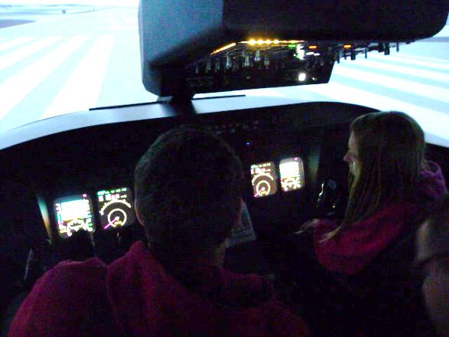
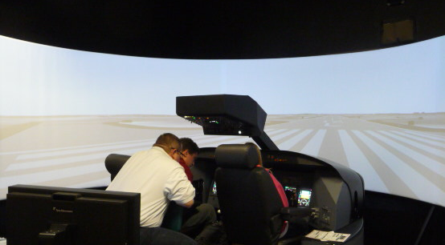
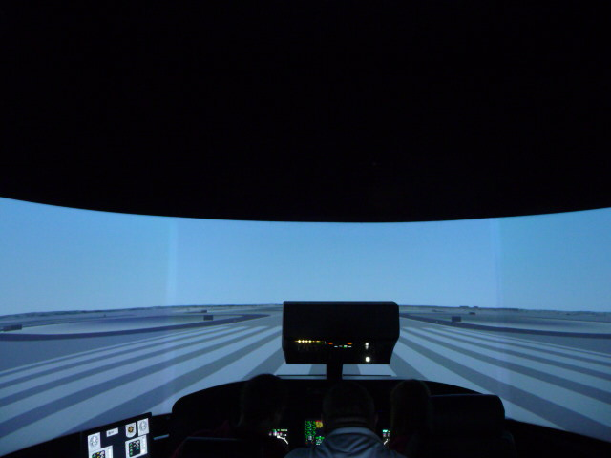
Simulation
AST FTD Hawk 201 (2000)
Frasca AATD (2008)
Redbird AATD (2009)
2 Redbird BATD (2011)
  Flight Center
  Library
Aerosim CRJ 200 FTD (2012)

Slide 9
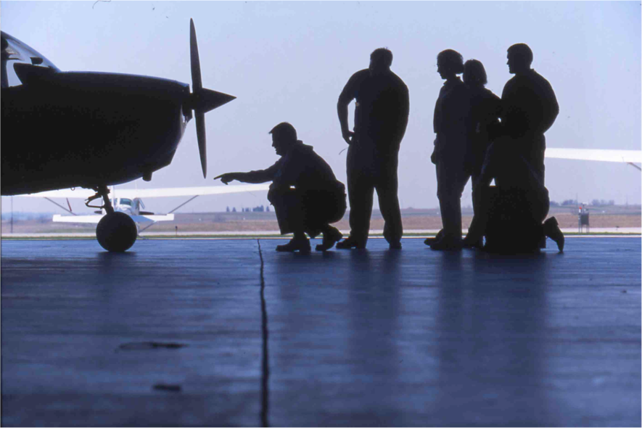
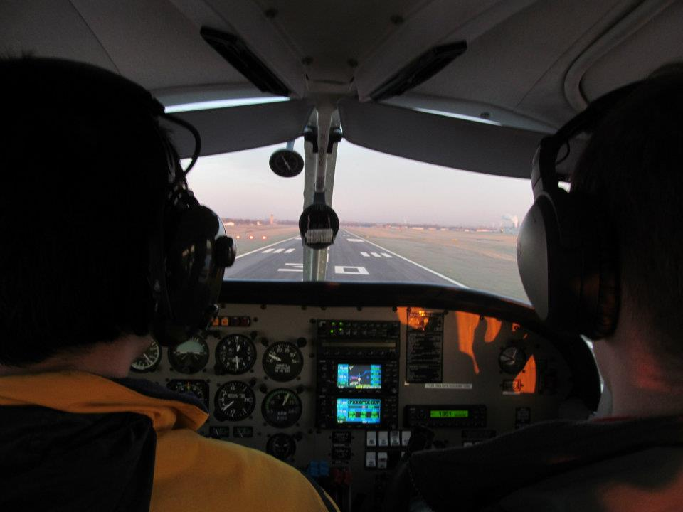
Checklist Discipline
Usage
CFI role
Training practices

Slide 10
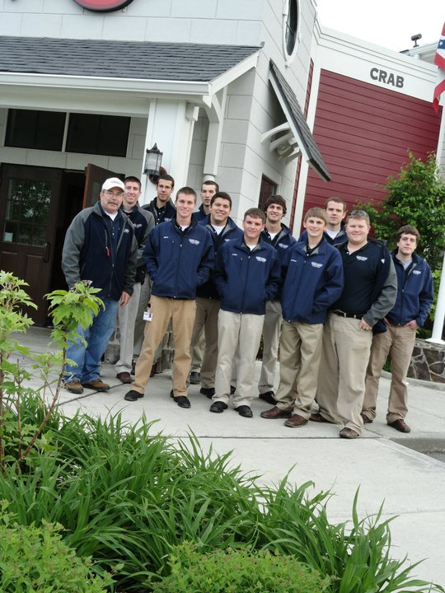
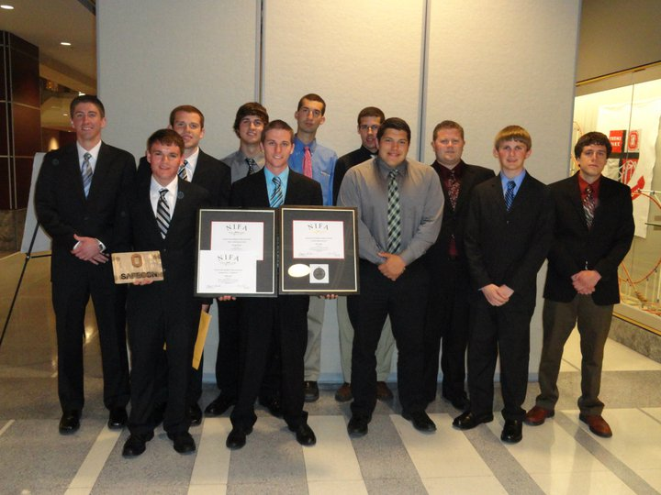
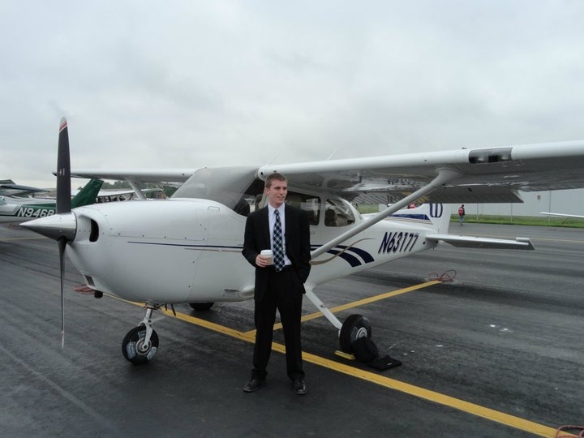
Flight Team Nationals
10 Students
2 Staff
CFI Chief Event Judge

Slide 11

LIFE Flight Certificate Program
Learning Institute for Fulfillment and Engagement (LIFE)
  New flight certificate program
  One year, 36 credits
  23 years of age with work experience

Slide 12
Inbound Class
Plane and Pilot Magazine
AOPA Recognition
Aerosim Spotlight
 | 2013 | 2012 | +/-
Applied | 183 | 143 | 40
Accepted | 138 | 103 | 35
Campus Visits | 126 | 113 | 13
Deposits | 69 | 43 | 26
Inquiries | 1975 | 1646 | 329

Slide 13
Scholarships
Scholarship | Amount
Blue Skies Over Dubuque | $ 300
Rebholz Aviation Scholarship | 1000
J. Andrew Bestor Prize for Aviation | 200
Welu Printing Company Scholarship (3) | 500
Scott W. Blackmon Memorial | 2000
David Dodds Memorial Aviation Scholarship (2) | 1100
Cessna Foundation (3) | 2500
Gordon Kibby (NATA) Scholarship (2) | 2500
Captain A. J. Metelak Memorial Scholarship | 1000
AOPA Scholarship (2) | 2000
Grant Vogt Memorial Scholarship | 830
Total Scholarship Funds Awarded: | $25,530

Slide 14

Management Major
Program Changes
  Chaminda Prelis

Slide 15
Total Credit Requirements
Minimum graduation requirement = 120
University Core Classes (including Senior Seminar) = 55
Aviation Management = 58 – 63
NOTE: Students need to take only 2 additional BAC classes to receive a minor in Business Administration

Slide 16
Aviation Requirements
Aviation Foundation Courses = 31
Business Foundation = 21 – 22
Aviation Concentration = 6 – 10
  General Aviation Management
  Airline Operations Management
  Air Traffic Management

Slide 17
Aviation Foundation Courses
AVI 131 – Basic Ground School
AVI 145 – Safety and Ethics in Aviation
AVI 233 – Air Transportation
AVI 322 – Aviation Human Capital & Employee Mgmt
AVI 333 – Aviation Security & Crisis Management
AVI 337 – Airport Management
AVI 341 – Aviation Law
AVI 349 – Aviation Safety Management
AVI 444 – Air Transport Economics & Finance
Option of Aviation Internship or Washington D.C. Aviation Seminar or Independent Research

Slide 18
Business Foundation Courses
BAC 120 – Macroeconomics
BAC 201 – Principles of Management
BAC 241 – Principles of Financial Accounting
BAC 242 – Principles of Managerial Accounting
BAC 280 – Principles of Marketing
BAC 300 – Principles of Finance
BAC 336 – Business Statistics or UDMA 150 – Analysis of Functions & Trig

Slide 19
Aviation Concentrations
GENERAL AVIATION MANAGEMENT
  AVI 344 – Corporate Aviation (3)
  AVI 348 – Fixed Base Operations (3)
AIRLINE OPERATIONS MANAGEMENT
  AVI 346 – Airline Management
  AVI 445 – International Airline Management & Operations
AIR TRAFFIC MANAGEMENT
  AVI 231 – Ground School – Instrument
  AVI 234 – Procedures and National Airspace System
  AVI 404 – Air Traffic Operations and Management

Slide 20
Questions?

Slide 21
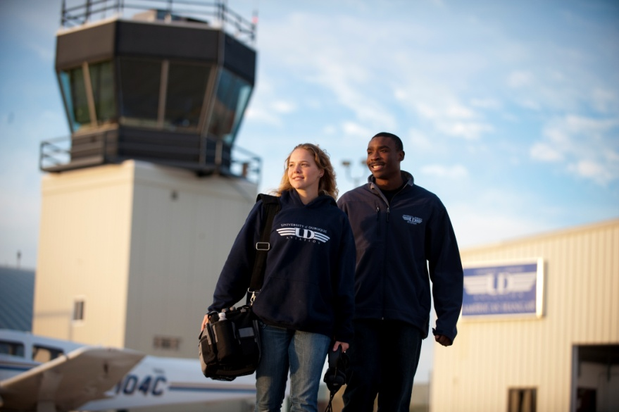
Non-Towered Operations at DBQ
Proposed UD procedures
Limitations
Costs
Situational awareness
Technology solutions (ADS-B)

Slide 22

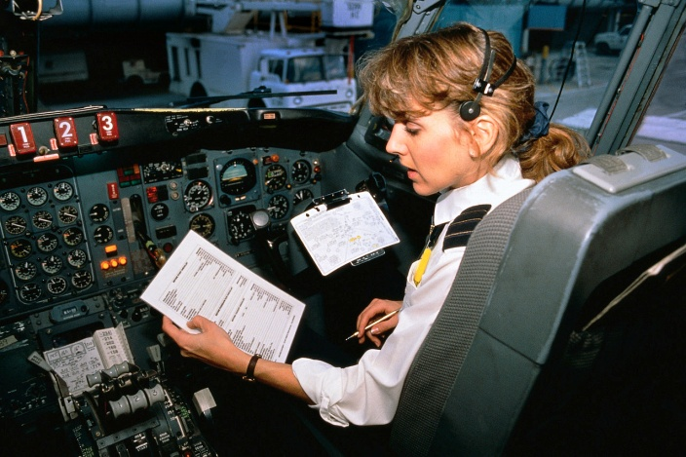
FO Qualifications
Breakout Session
Multi-Engine Time (50 Hours)
Cross-Country Time (200 Hours)
Time Building – CFI
ATP Written

Slide 23
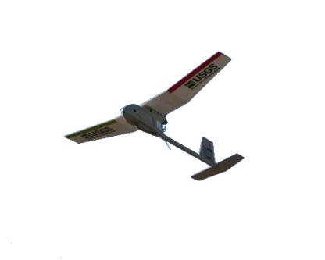
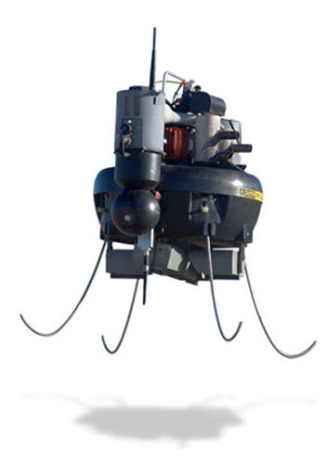

UAS Program
Does it fit into our majors?
How much would it cost?
Is there a need?

Slide 24

Aviation Masters
Is there a need?
Do we have the expertise?
PhD required?
Cost effective?

Slide 25
Faculty/Board Partnership
Faculty/Staff
Steven Accinelli
Polly Kadolph
Ken Godwin
Chaminda Prelis
Willy Rigdon
Mike Glynn
Brett Ray
AAB Member
Mark McClain/Wally Brown/Ted Rebholz
Bryan Hawley
Robert Grierson/Mike Sterenchuk
Heath Miller
Jim Stokes
Barry Brown
Jon Harberts

Slide 26
Resolutions

Slide 27
Thank You!
For your generous contribution of time, talent, and expertise to the University of Dubuque

